Slide 1

Course REGISTRATION System
Angelica Topete
University of Arizona Global Campus
CST499: COMPUTER SOFTWARE TECHNOLOGY
JOSEPH RANGITSCH
JULY 24, 2023

Slide 2





INTRODUCTION
The purpose of this PowerPoint is to present the proposed platform for the course registration system, with the goal of simplifying the process for students.
This presentation offers a comprehensive overview of the system’s architecture and the design of its individual components.
By the end of this presentation, you will have a clear understanding of the systems' inner workings and its benefits.

Slide 3
SOFTWARE Requirements Specification (SRS)
The Software Requirements Specification (SRS) document outlines the scope and functionalities of the course registration system (Tsui, et al., 2018).
SRS document includes the following:
Product scope
Key Functionalities
System Requirements
System Functionalities
Testing Plans
UML Modeling
SRS Purpose:
To describe what the proposed software must is expected to perform based on the stakeholders needs (Tsui et al., 2018).
Example of SRS For Couse Registration System
Product Scope:
User friendly online platform for students to register and manage class enrollments efficiently.
Key Features of system:
New user registration
Includes account and profile creation
Profile
Includes key info (name, phone, email, etc.).
Login
Using email and password created at registration
Course listing
Run three semesters (Spring, Summer, Fall)
Max enrollment
Waiting list management

Slide 4
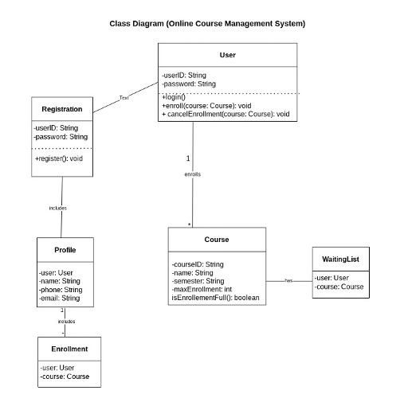
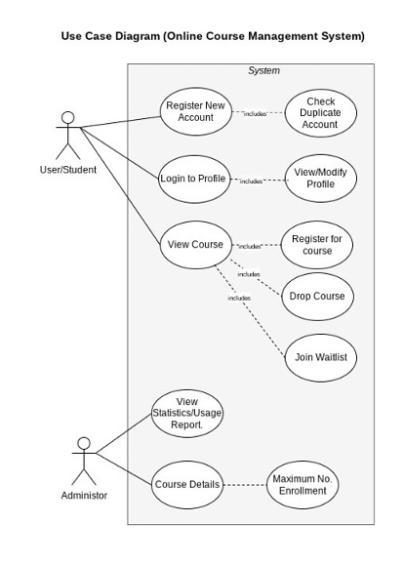
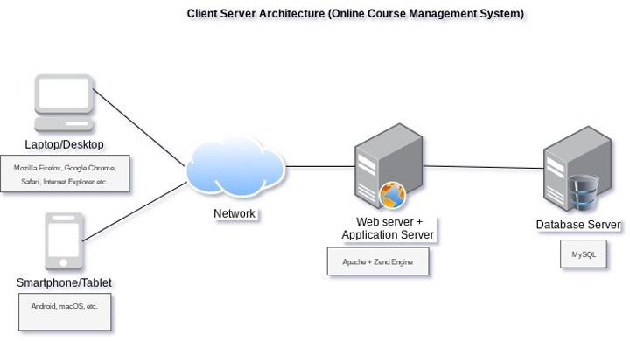
UML Design Models
The deployment diagram shows the system's architecture, illustrating the hardware and software components and their environment (Tsui et al., 2018).
This diagram visually represents how the website is deployed and demonstrates the connections and relationships between the elements.
The class diagram provides a comprehensive representation of the structure of the course registration system (Tsui et al., 2018).
It visualizes the different classes within the system including
Attributes
Methods
Relationships.
The use case diagram serves as a visual representation of the system's various roles and interactions (Tsui et al., 2018).
This diagram provides a clear overview of the distinct roles involved and illustrates how these roles interact with the system.
Unified Modeling Language (UML) provides visual representations of the systems structure and behavior (Tsui et al., 2018).

Slide 5
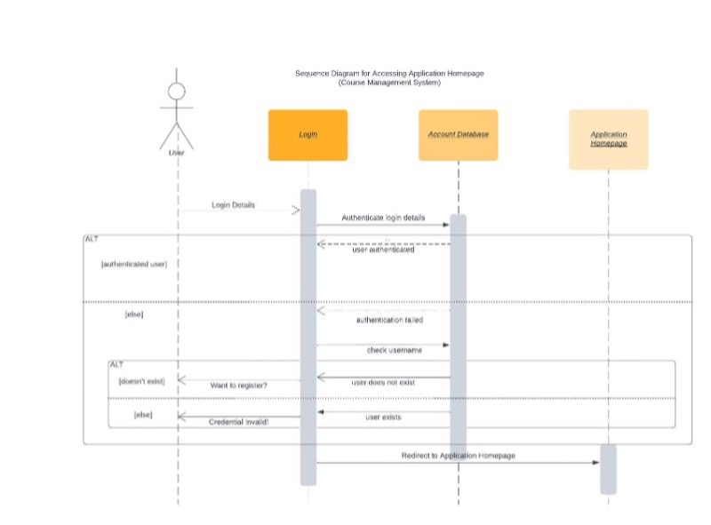
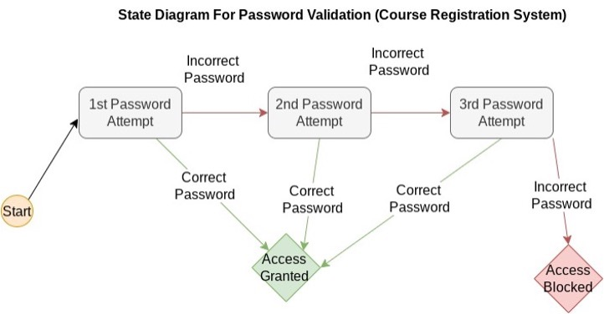
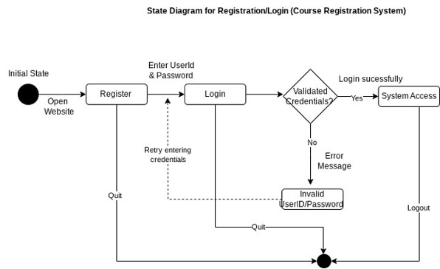
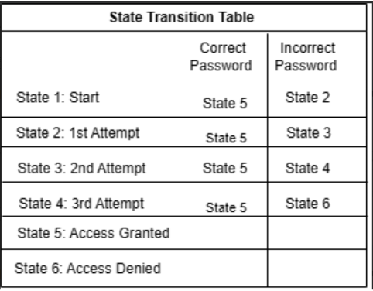
UML Design Models
UML Design Models (Continued)
The state diagram for the system's password verification feature illustrates a security feature that blacks account access after the 3rd consecutive failed password attempt.
Access to the system is granted if the correct password is entered before the third attempt.
The state diagram is designed to illustrate the different states that the system can be in (Tsui et al., 2018).
In this particular diagram, we focus on the control flow within the system, specifically based on the user's input.
The sequence diagram provides a visual representation of how objects interact within a specific use case (Tsui et al., 2018).
In this case, the deployment diagram models the flow of interaction between the system when a user accesses certain functions (specifically how the system interacts at login).
The state transition table shows the transition states for the password verification system (Tsui et al., 2018).

Slide 6
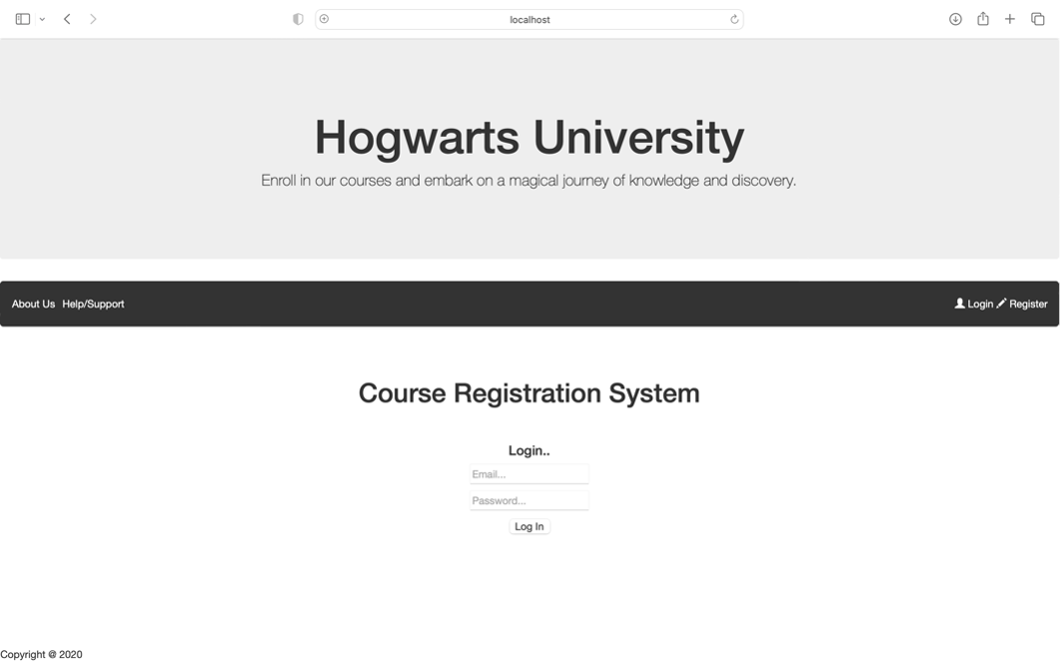
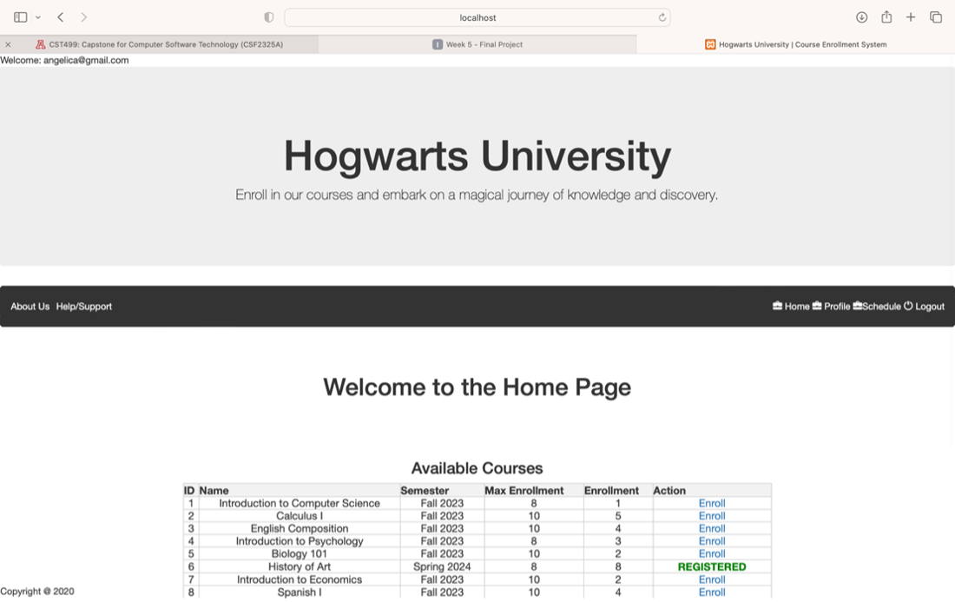
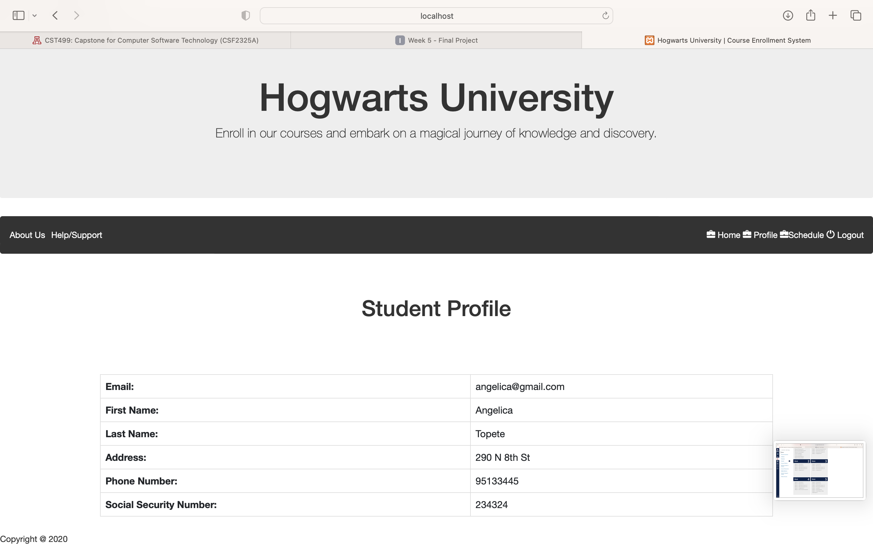
Interface Design
The user interface design focuses on simplicity and ease of use.
Landing Page/Login
Profile
Home/Course Registration

Slide 7
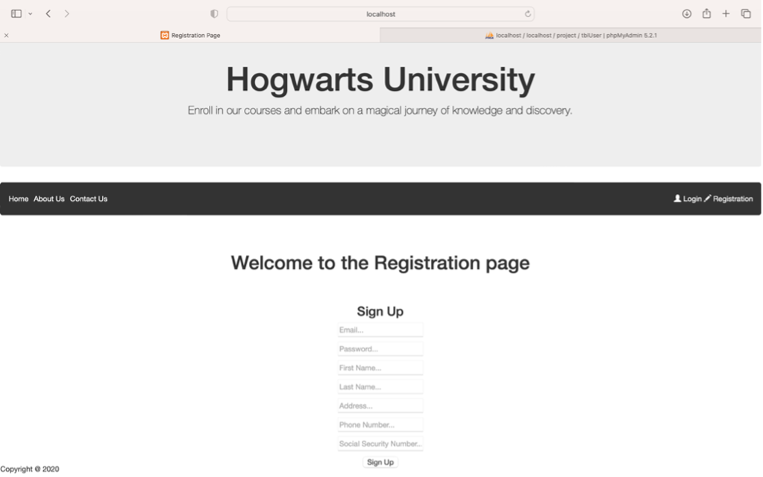
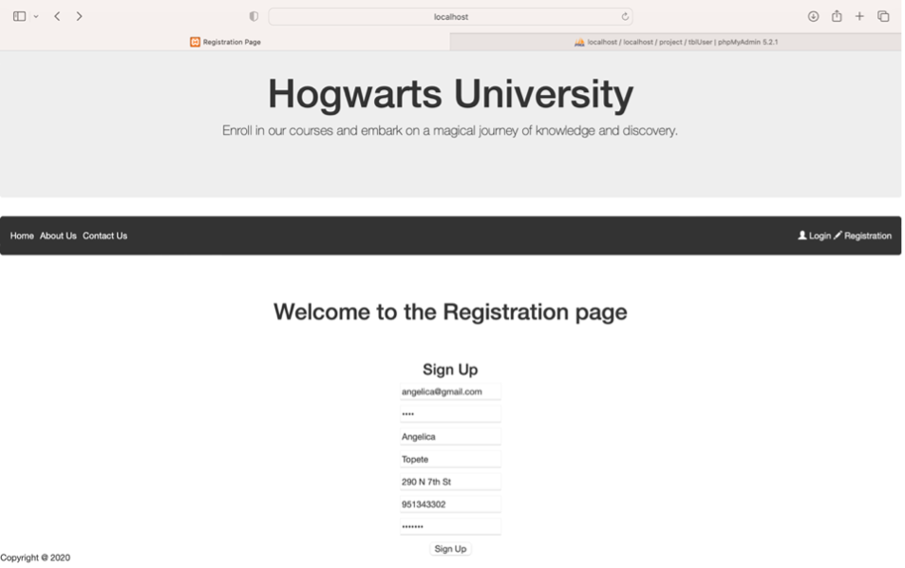



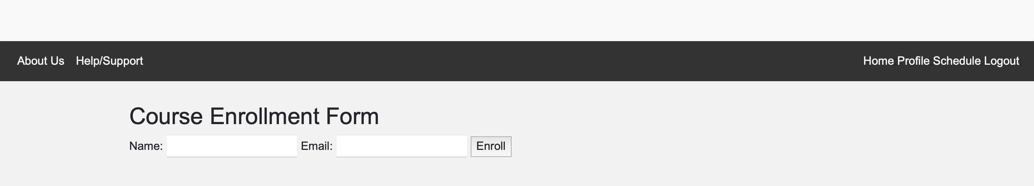
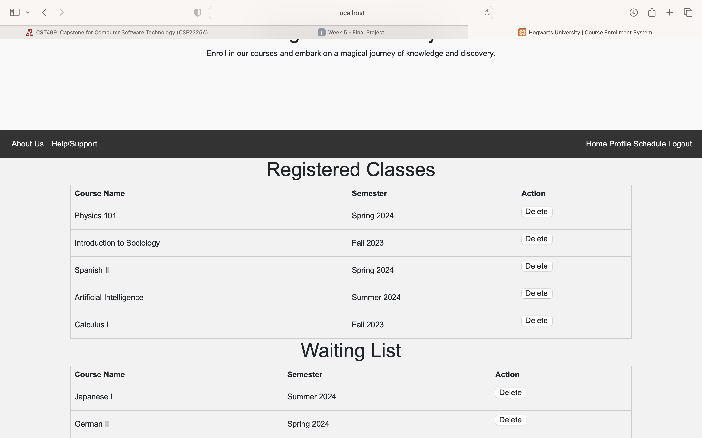
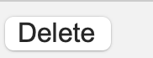

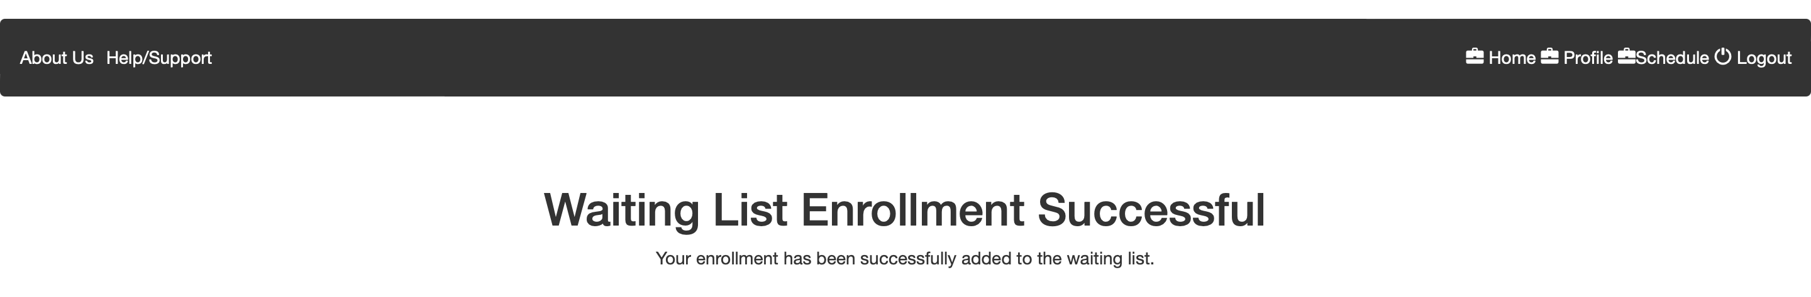
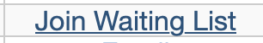

Interface Design
Registration Page
Active Registration
Error Message (User Exists)
Successful User Registration
Enroll to Course/Join Waitlist
Enroll to Course/Waitlist Form
User Schedule Page
Delete Course Button
Buttons
Successful Course/Waitlist Enrollment
Successful Course Deletion Message
(….continued)

Slide 8


Overview of MySQL Databases
MySQL is a relational database used to store user and course information.
MySQL is capable of managing databases quickly, handling large amounts of data, supporting multiple users (Stanescu et al., 2007).
Following images show,
Database Schema: Tables for user information, courses information, and the waiting list.

Slide 9
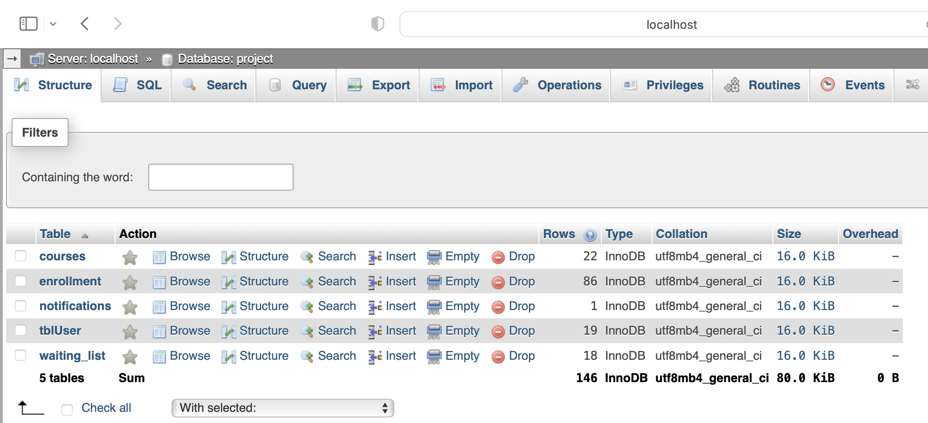
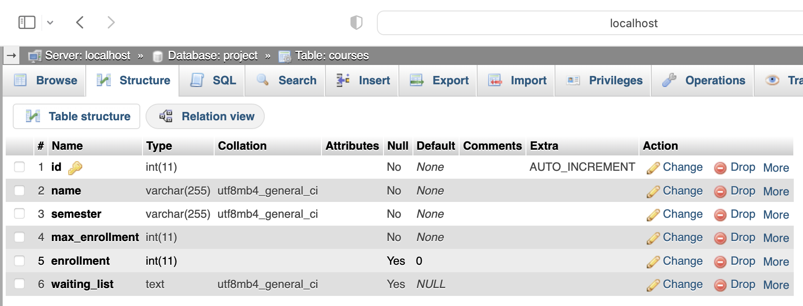
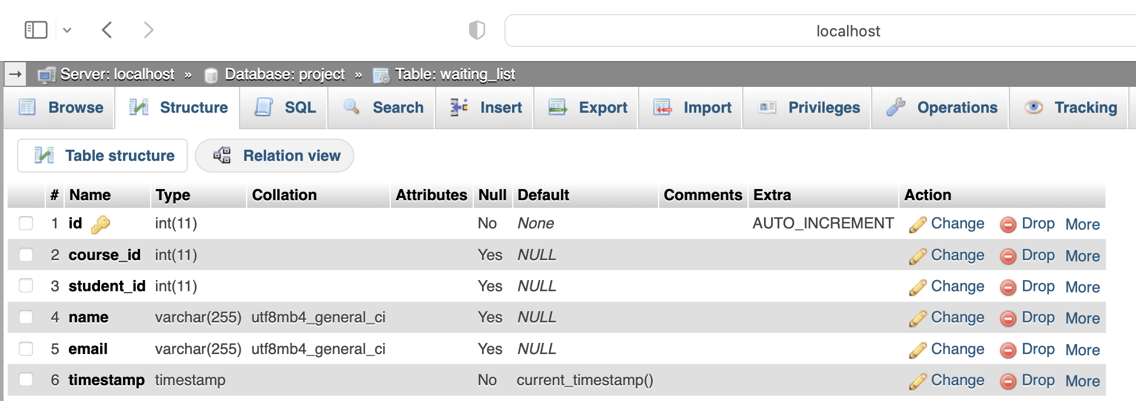
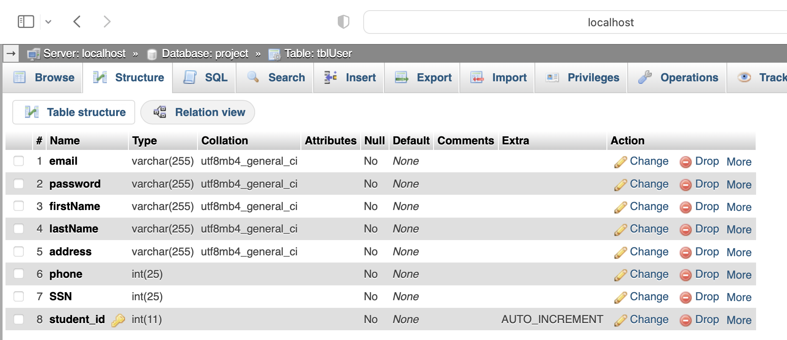
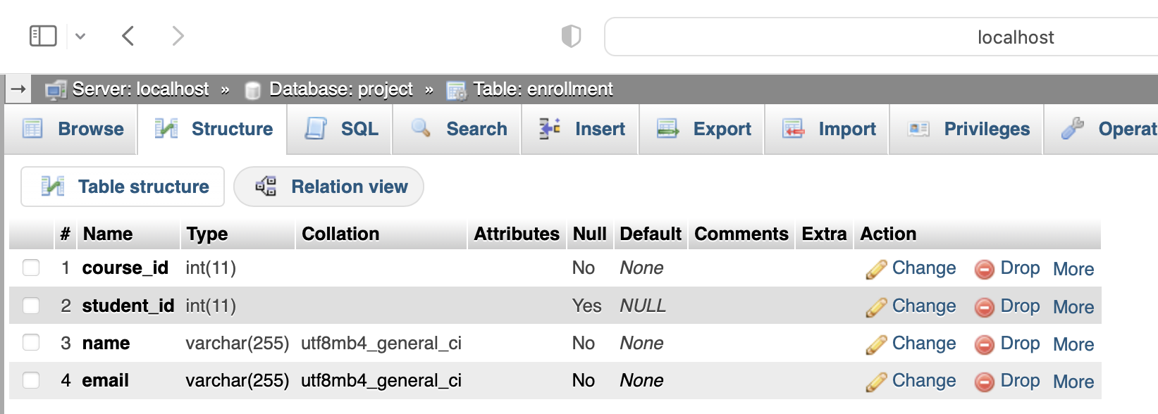
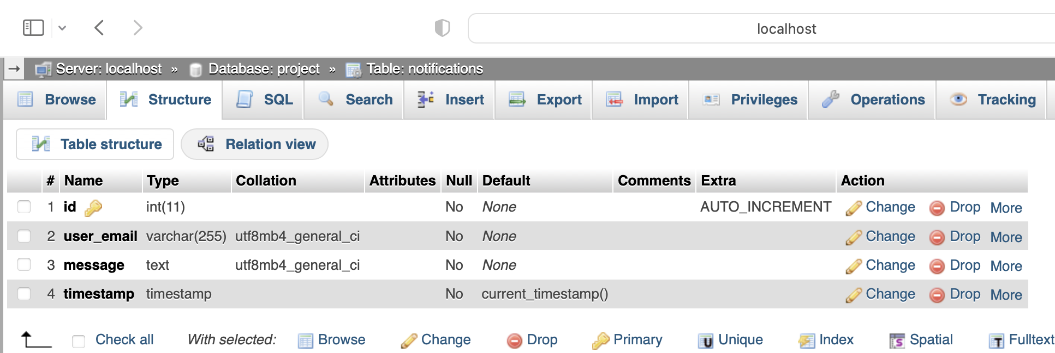
Structure of MySQL database & Class Registration
for course registration system.
Overview of ‘project’ database
Structure of ‘courses’ Table
Structure of ‘waiting_list’ Table
Crucial component of the course registration system.
Houses comprehensive university course information, enabling efficient management of course registrations and waiting lists.
Serves as a crucial role in enrolling a student into the waitlist for a specific course, ensuring effective management of waitlist registrations within the system.
'project' database along with its corresponding tables.
Foundational structure of the course registration system.
Structure of ‘tblUser’ Table
Structure of ‘enrollment’ Table
Structure of ‘notifications’ Table
Houses crucial user information.
Stores information that enables user to register, login, add course/waiting enrollment, and delete courses.
Plays a crucial role in the process of enrolling a student into a specific course, facilitating smooth course registration within the system.
Serves as a crucial role in storing waitlist notifications for system functionalities such as notifying the next user in the courses waitlist that there is an available spot.

Slide 10
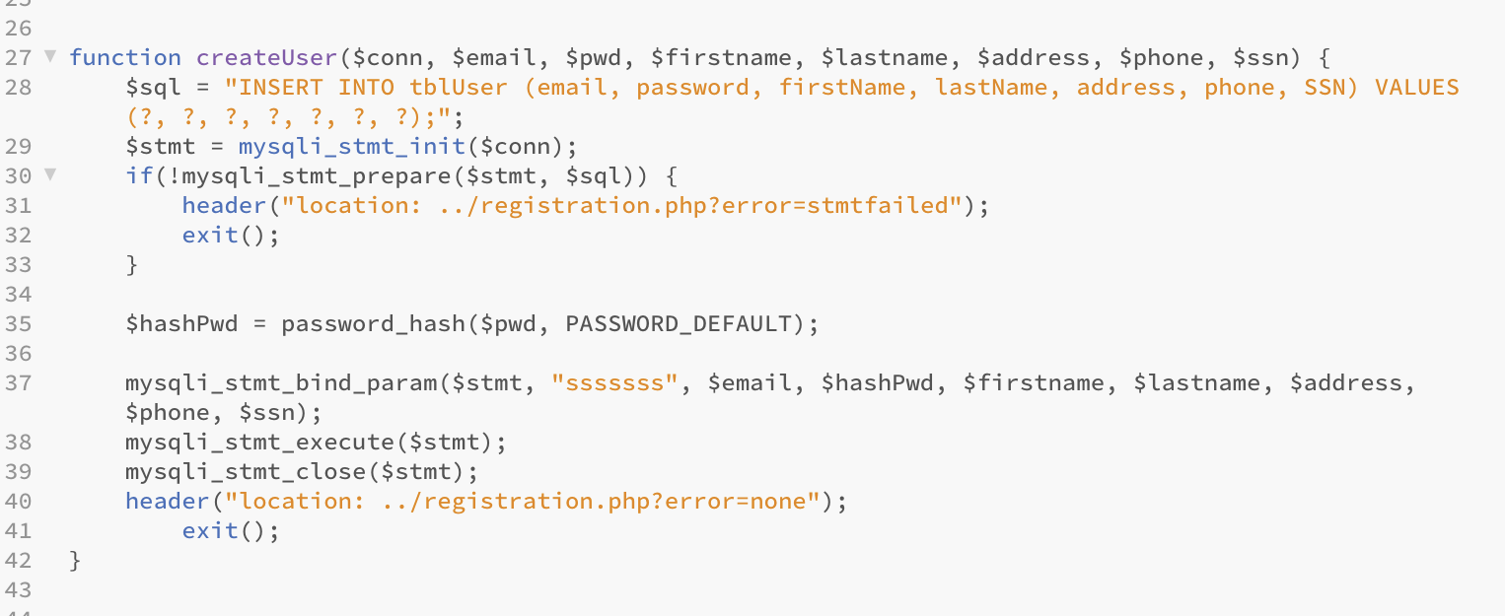
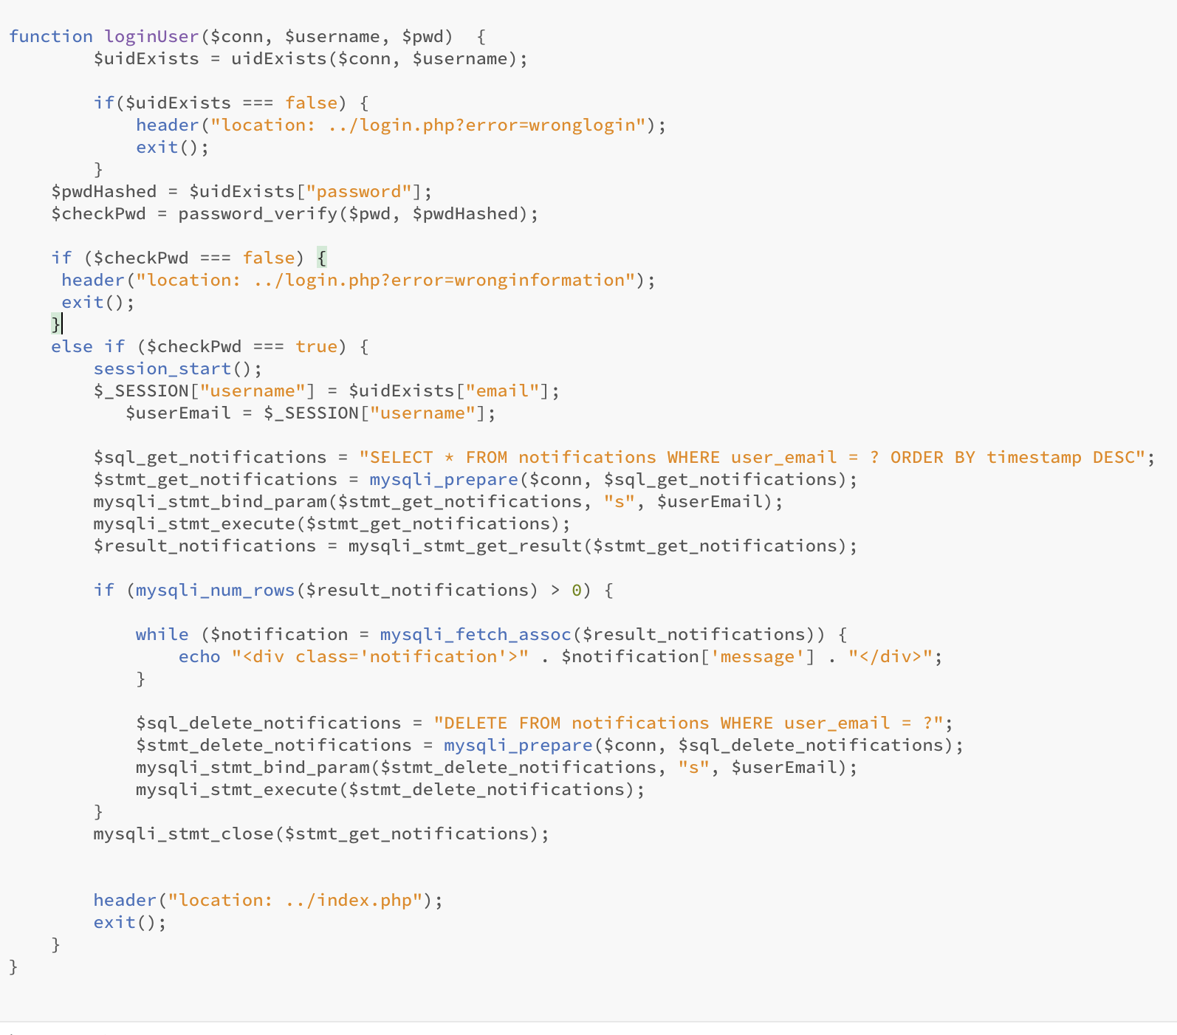
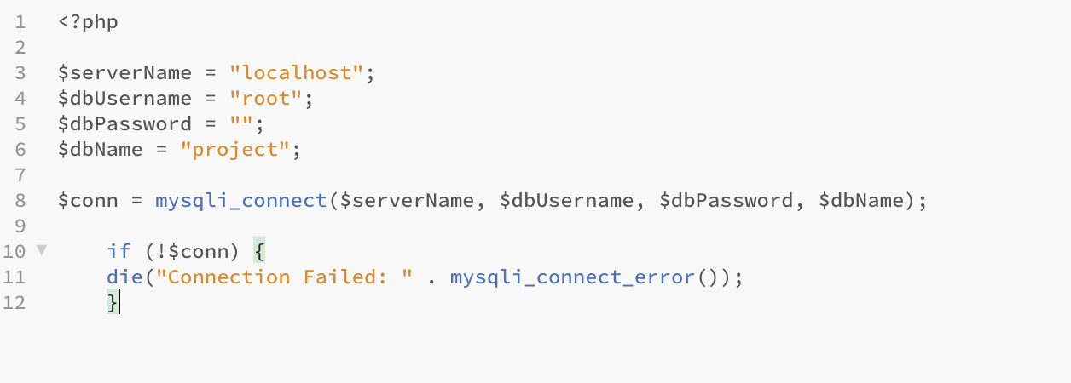
Php Code
Registration Process PHP Code
PHP serves as the most favored web scripting language for the project (Anand, 2019).
The PHP code interacts with the database to handle user authentication, course enrollment, and waiting list management as well as to display necessary information on the web application.
User Login PHP Code
Database Handler PHP Code
Inserts a new user record into the databases with provided user information.
User passwords are securely hashed before storage.
If any errors occur during execution, the user will be redirected to the registration page with appropriate error messages.
Establishes a connection to the MySQL database using PHP’s mysqli extension
Defines the database parameters (database server name, username, password, and database name required for connection.
Uses the if statement to check if the connection was successful.
If connection failed, an error message is displayed.
Responsible for handing user login authentication
Function Steps:
1. validate user existence
2. verify password
3. successful login
4. notification handling
5.redirection.

Slide 11
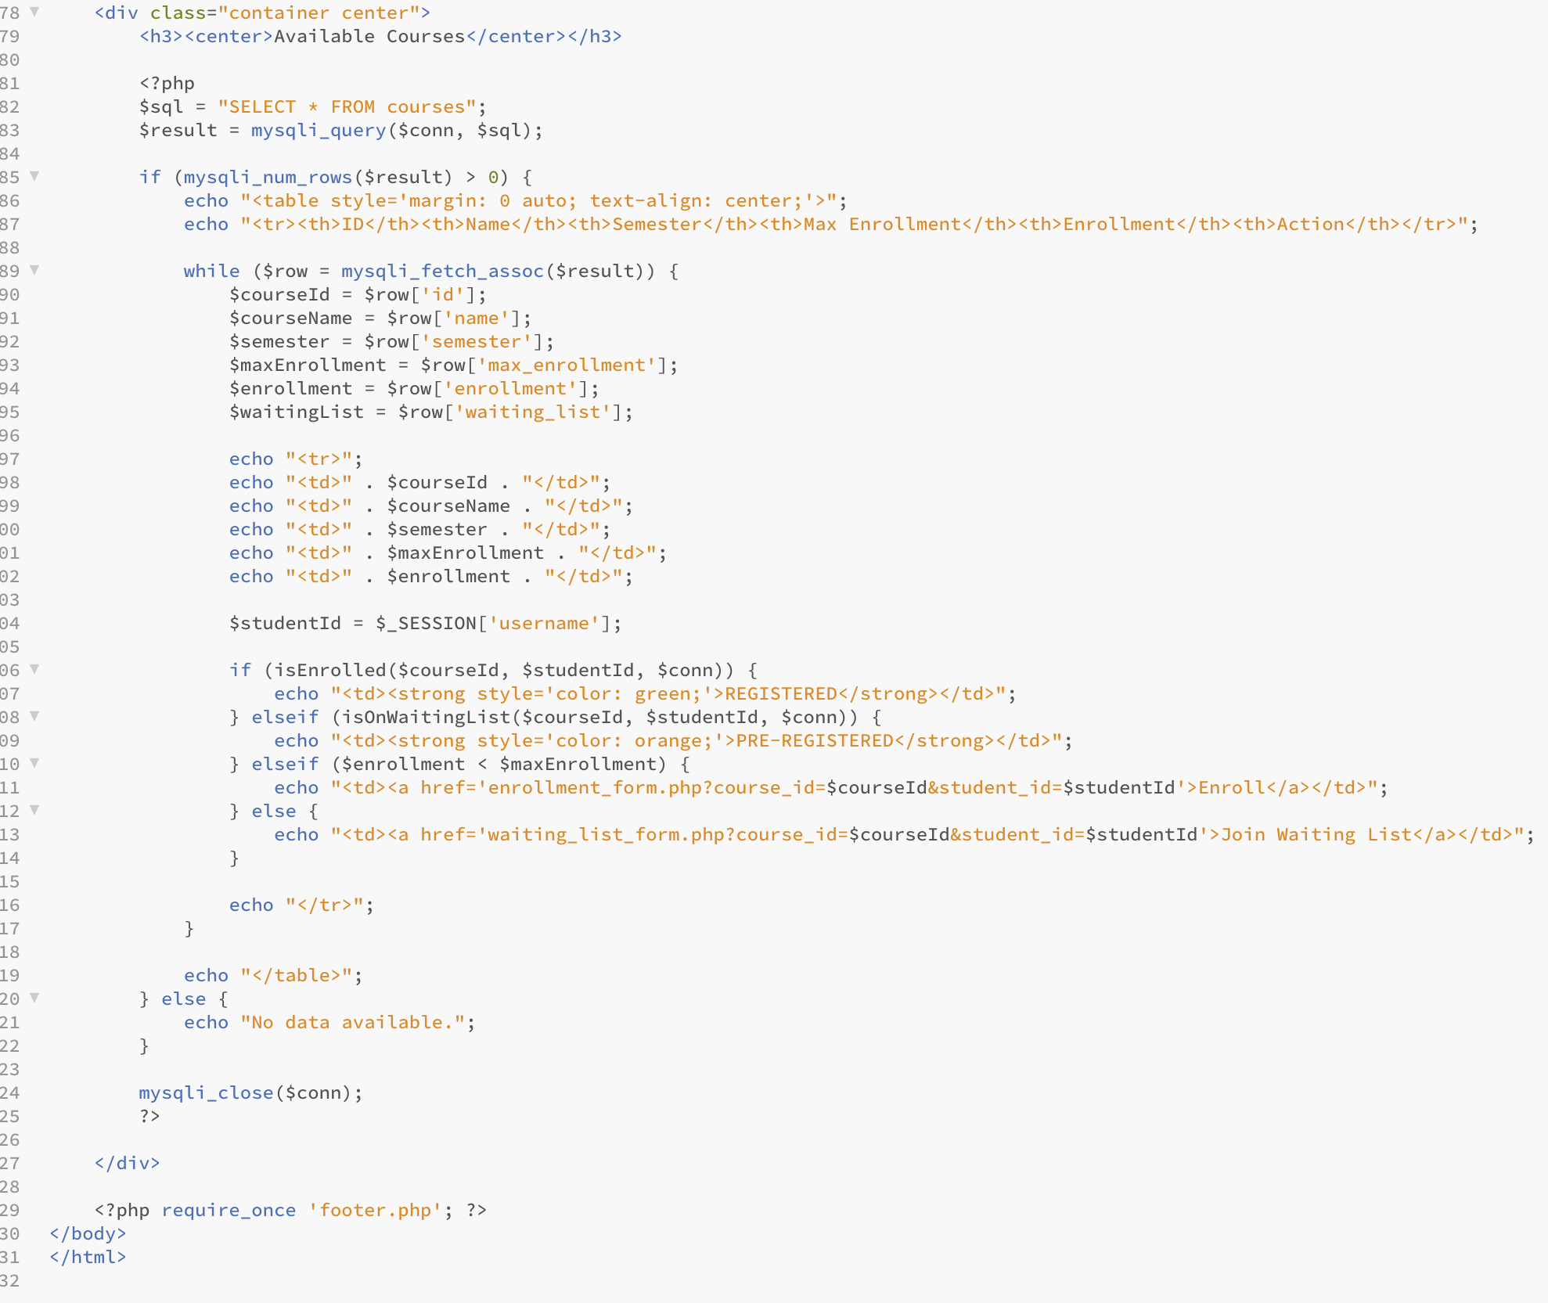
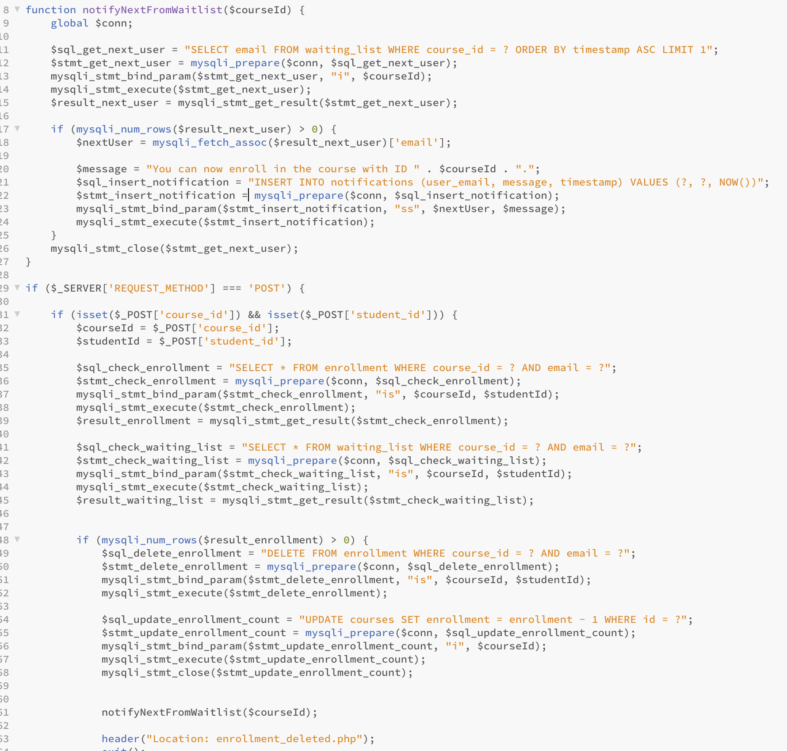
Php code
(….continued)
Course Enrollment PHP Code
Notify Next User From Wait List Code
Displays the available courses to the logged-in user and provides options to enroll in a course or join the waiting list.
Each course's ID, name, semester, maximum enrollment, current enrollment, and action options are presented in a table format.
If the student is already enrolled in a course or on the waiting list, their status is indicated with "REGISTERED" or "PRE-REGISTERED.”
Otherwise, the student can choose to "Enroll" in an available course or "Join Waiting List" if the course is already full.
If no data is available, an appropriate message is shown.
Handles course enrollment and wait list management for students.
First checks if the student is already enrolled in the selected course or on the waiting list.
If enrolled, the code removes the enrollment and updates the enrollment count of the course, then notifies the next student on the waiting list.
If on the waiting list, the code removes the student's record and notifies the next student.
The code then redirects the user to relevant pages based on the performed action or error occurrence.

Slide 12


Conclusion
Successful completion :
Streamlined course registration system
Key Features Implemented:
user registration, login, course listing, enrollment, constraints
Future Enhancements:
course search functionality, email notifications for wait list updates.

Slide 13

References
Anand, B. (2019). Making the Web 2.0 Faster for Next Generation. IJEAT, 1(9), 2922-2924. https://doi.org/10.35940/ijeat.a1237.109119
Connolly, R., & Hoar, R. (2018). Fundamentals of web development (2nd ed.). Pearson. https://platform.virdocs.com/read/350543/121/#/4/2[P7001013820000000000000000004E13]/2/2[P7001013820000000000000000004E14]/4,/1:0,/1:0
Stanescu, L., Burdescu, D., Brezovan, M., Stoica, C. (2007). A Multimedia Database Management System For Medical Data. https://doi.org/10.5220/0002137203610364
Tsui, F., Karam, O., & Bernal, B. (2018). Essentials of software engineering (4th ed.). https://platform.virdocs.com/read/2348054/9/#/4/2[ch04]/6/6[ch04-sect1-003]/6[ch04-sect2-007]/4,/1:287,/1:287

